Slide 1
Enumerated Types
by B. Molutov

Slide 2
Simple Enumerated Types
An enumerated type defines a list of enumerated values. Each value is an identifier.
Example, the following statement declares a type, name MyFavoriteColor, with values RED, BLUE, GREEN, and YELLOW.

Slide 3

Simple Enumerated Types
A value of an enumerated type is like a constant and so, by convention, is spelled all uppercase letters.
Once a type is defined, you can declare a variable of that type:
The variable color can hold one of the values defined in the enumerated type MyFavoriteColor or null, but nothing else. Java enumerated type is type-safe, meaning that an attempt to assign a value other than one of the enumerated values or null will result in a compile error.

Slide 4


Simple Enumerated Types
The enumerated values can be accessed using the syntax
The following statement enumerated value BLUE to variable color
As with any other type, you can declare and initialize a variable in one statement

Slide 5
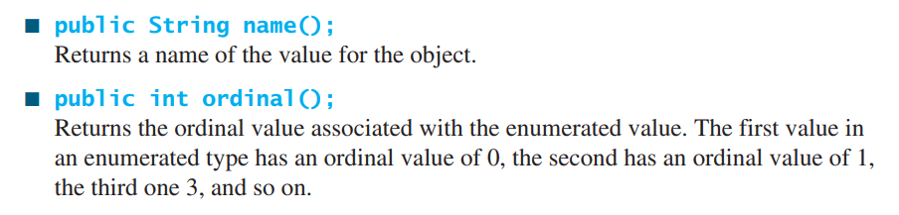
Simple Enumerated Types
An enumerated type is treated as a special class. An enumerated type is a subtype of the Object class and the Comparable interface.
Therefore, an enumerated type inherits all the methods in the Object class and the compareTo method in the Comparable interface. Additionally, you can use the following methods on an enumerated object

Slide 6
Simple Enumerated Types
# see code example EnumeratedTypeDemo.java
# see code example StandaloneEnumeratedTypeDemo.java

Slide 7
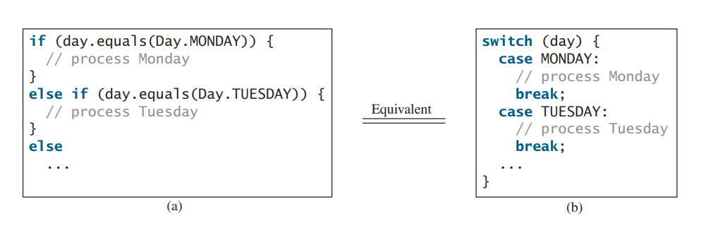
Using if or switch Statements with an Enumerated Variables
An enumerated variable holds a value. Often your program needs to perform a specific action depending on the value. For example, if the value is Day.Monday, play soccer; if the value is Day.TUESDAY, take piano lesson, and so on. You can use an if statement or a switch statement to test the value in the variable.

Slide 8

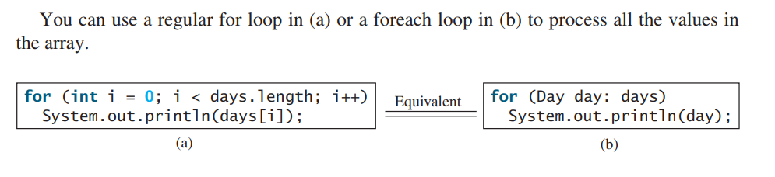
Processing Enumerated Values Using a Foreach Loop
Each enumerated type has a static method values() that returns all enumerated values for the type in an array. For example,

Slide 9
Enumerated Types with Data Fields, Constructors, and Methods
You can also define enumerate type with data fields, constructors, and methods.
# see code example TrafficLight.java

Slide 10
Important note
The java syntax requires that the constructor for enumerated types be private to prevent it from being invoked directly. The private modifier may be omitted. In this case, it is considered private by default.

Slide 11
Also see examples:
SwitchExample.java
LoopingExample.java

Slide 12
Difference between Enums and Classes
An enum can, just like a class, have attributes and methods. The only difference is that enum constants are public, static and final (unchangeable – cannot be overridden).
An enum cannot be used to create objects, and it cannot extend other classes (but it can implement interfaces).

Slide 13
Why And When To Use Enums?
Use enums when you have values that you know aren’t going to change, like month days, days, colors, deck of cards, etc.

